Slide 1
Optimization Techniques to Extract Aerodynamic Parameters
Arthur Shune

Slide 2
Outline
[03m] Setup/background
[05m] Project background
[05m] An overview of non-linear constrained optimization
[02m] Overview of aerodynamics model used
[08m] Applications for Max L/D guidance
Trimming the vehicle
Maximizing body forces
[02m] Issues faced and solution
[35m] Q&A

Slide 3

My Background
Some projects I’ve worked on:
Real-time adjustment of the planned intercept point for a ground-to-air weapon using a clustering algorithm
Sensitivity analysis of customer missions using Bayesian networks
Radar modeling & analysis tools
Vehicle predictive maintenance using neural networks
Why I chose this project:
My work is now used throughout the program
Unclassified
Relevance
Notes:
I want to demonstrate that I can apply numerical techniques to aerospace problems of a wide and varied nature. Depending on where you are in launch trajectory could be minimizing deltaV as a function of transfer TOF and delay time, etc. Also, want to demonstrate that I have the ability to learn new methods and concepts quickly to solve a problem I haven’t dealt with before.

Slide 4
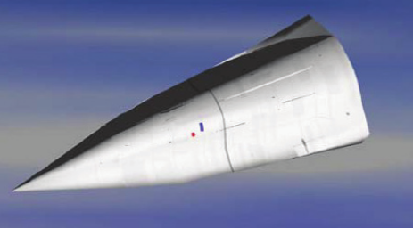
Project Background
Development of a novel midcourse guidance mode required for a new interceptor
Based on mission requirements
Desire to maximize crossrange by gliding for as long as possible
Requires maximizing L/D at all possible flight conditions
Additional trimmed flight parameters necessary

Slide 5



Midcourse Guidance Strategy Inputs/Outputs
Guidance
Model
G-limits
Aerodynamics
Force Coefficients
Control
$${L/D}_{max}$$
$γ_{cmd}$ for ${L/D}_{max}$
$α$,$β$ for ${L/D}_{max}$
Notes:
The commanded flight path angle is computed from estimates of best L/D and the corresponding true airspeed is computed from the estimated aerodynamic forces (lift, drag, sideforce)

Slide 6
Midcourse Guidance Strategy Inputs/Outputs
Guidance
Model
G-limits
Aerodynamics
Force Coefficients
Control
$${L/D}_{max}$$
$γ_{cmd}$ for ${L/D}_{max}$
$α$,$β$ for ${L/D}_{max}$
Notes:
The red box indicates my involvement in the process. Work is to decouple the model from the guidance module by generating lookup tables

Slide 7

Optimization Terminology
Objective function – the function whose maximum/minimum is to be determined
Constraint – some restriction on the range of allowable inputs to the objective function
Boundary constraints – max/min values for one or more of the input variables (e.g. max individual fin deflection, max alpha)
Linear constraints – constraints expressible as a linear system $Ax=b$ (equality constraints) or $Ax≤b$ (inequality constraints)
Example: Aerodynamics model takes deflection commands (e.g. pitch), but fin deflection limits are for individual fins
$A$ in this instance would be the fin mix from deflection commands (e.g. $ι,ι^{′},δ,δ_{SB}$ to $f_{1},f_{2},f_{3},f_{4}$)
$b$ in this instance is the max permissible fin deflection
Nonlinear constraints – constraints not expressible as a linear system (e.g. vehicle trim is a nonlinear equality constraint)
Feasible solution – a set of input values that satisfies all constraints
Optimality – conditions that must be satisfied for a solution to be considered optimal (Karush-Kuhn-Tucker (KKT) conditions or some variant)
Local vs. global optimum: global is the best solution in the entire problem domain, whereas a local optimum is the optimal solution in some neighborhood

Slide 8
Optimization algorithms available in MATLAB:
Initialization
Two main algorithms for aero applications – many more optimization algorithms exist but are unsuitable for constrained optimization
fmincon()
Constrained optimization dependent on objective function and constraint gradients
Very fast, but can have issues with poorly behaved objective functions/constraints/gradients
Our aerodynamics models are piecewise linear (due to linear interpolation), meaning the gradients are discontinuous
Typically means the solution found by fmincon() is feasible but not provably optimal (though it is typically optimal in practice)
If it works, it will find a local minimum
Ideal stopping condition flag is “1” (provably optimal solution), but any value > 0 is likely acceptable
Stopping condition of “2” is common due to discontinuous gradients, but is almost always acceptable
ga() (genetic algorithm)
Constrained optimization with no gradient dependence
Very slow compared to fmincon()
More likely to find the global minimum
Outputs do not give a clear indication as to whether the solution is truly optimal
Fitness Assignment
Selection
Crossover
Mutation
Stopping criteria = false
Stopping criteria = true

Slide 9
More on Optimization in MATLAB
fmincon() is sufficient for most cases – so I use ga()as a last resort
My workflow attempts optimization with fmincon() and, if the stopping condition flag is not the desired value, reattempts using ga()
Can prove useful if the gradients, etc. are poorly behaved at some flight conditions, e.g. when there is fin stall
The strong dependence of optimization algorithms on gradient information is evidence in favor of including derivatives as outputs from aerodynamics models and/or ensuring aero model outputs are differentiable at all points

Slide 10
Aerodynamics Model Used
Main Body
$$+φ$$
Main Coefficient | Force/Moment Coefficient
CA | -CFx
CYb | CFy
CNb | -CFz
CLL | CMx
CLMb | CMy
CLNb | CMz
Maneuver Plane
CNb
CNm
Launch lugs (45° from fin 1)
Fin 1
Command | Fin Mix
Pitch (“iota”) | (F2 – F4) / 2
Yaw (“iotaPrime”) | (F3 – F1) / 2
Roll (“delta”) | (F1 + F2 + F3 + F4) / 4
Speed brake (“sigma”) | (F1 – F2 + F3 – F4) / 4
Aft looking forward
CYm
CLMm
X-axis
CLMmad
Body Y-axis
Lowercase “b”: body frame
Lowercase “m”: maneuver frame
Fin 2
Maneuver Y-axis
Fin 4
-CA
CYb
CLL
CLLp
CLMb
Legend:
Green: trailing edge positive fin deflection (“screw-out”)
Purple: force
Blue: moment
Red: damping
CLNbr
Fin 3
CLMbq
Maneuver Z-axis
$$v_{tot}$$
CLNm
= into page
CLNb
Body Z-axis

Slide 11
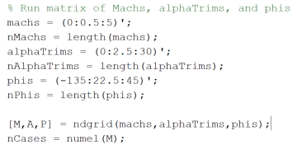
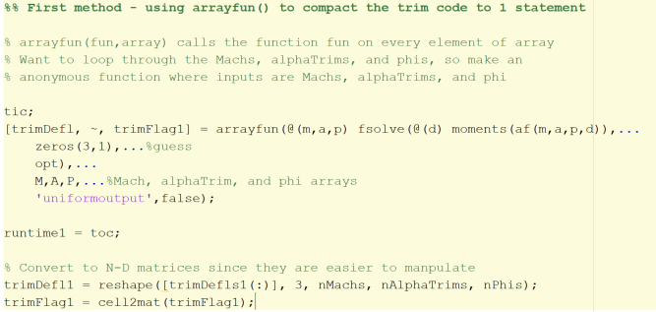


Trimming the Vehicle (1)
Excerpt from trimTest.m
Required to trim the aircraft over all flight conditions:
Machs, altitudes, $α$,$β$
Two possible methods:
Use arrayfun()
One line of code
Can’t use trim deflections at subsequent flight conditions as the “guess”
Use a for-loop
Slight speed advantage over arrayfun() if previous solution is used as the starting guess for the current flight condition

Slide 12
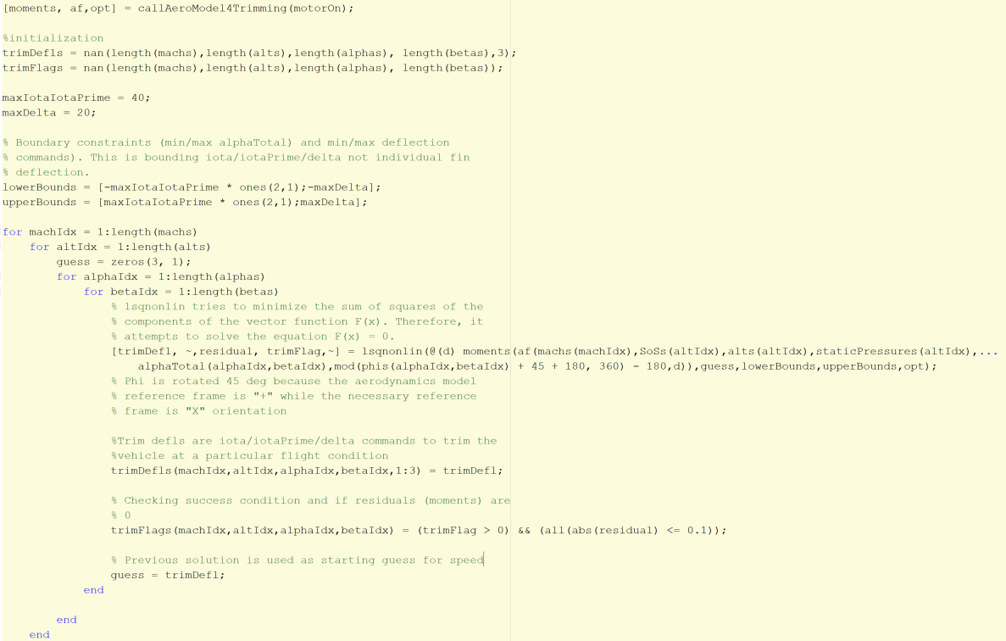
Trimming the Vehicle (2)
MATLAB Excerpt:
Trimming a vehicle at a given flight condition – find the control surface deflections at which the aero moments are zero (a root-finding problem)
Existing tools usually do this by calculating the Jacobian and solving a linear system to calculate the step in the deflection space
Functional most of the time, but there are differences in the calculation of the Jacobian, how deflection limits are handled, convergence tolerance, etc.

Slide 13
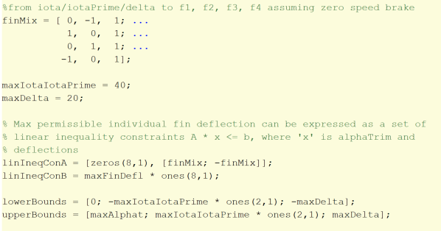


Extracting Aerodynamic G-limits (1)
Want the max body forces where the vehicle can still be trimmed
This is an optimization problem
Objective function: (Cy,Cn) (maximize)
Dimensionality: number of deflections + 1 (for alpha) + 1 force at a time
Constraints:
Max individual fin deflection
Boundary constraint if objective function uses individual deflections
Linear inequality constraint if objective function uses commands (e.g. $ι,ι^{′}, δ,δ_{SB}$)
Max deflection commands
Boundary constraint if objective function uses commands
Linear inequality constraint if objective function uses individual deflections
Example: if data from wind tunnel goes to roll = 20°, but individual fin deflections are limited to 40ׄ°, then this constraint is needed since individual fin deflection will not capture this data limitation
Moments = 0 (nonlinear equality constraint)
4 Dimensions (alpha + 3 deflection commands ($δ_{SB}=0°$))
$\text{Vehicle} \text{fin} \text{mix}\text{:}$ fmincon() linear constraint arguments:
$f_{max}=40°$ First 4 rows: $f≥{−f}_{max}$, second 4: $f≤f_{max}$
$$\left[\begin{matrix}f_{1} \\ f_{2} \\ f_{3} \\ f_{4}\end{matrix}\right]=\left[\begin{matrix}0 & −1 & 1 \\ 1 & 0 & 1 \\ 0 & 1 & 1 \\ −1 & 0 & 1\end{matrix}\right]\left[\begin{matrix}ι \\ ι^{′} \\ δ\end{matrix}\right], \left[\begin{matrix}f_{max} \\ f_{max} \\ f_{max} \\ f_{max} \\ f_{max} \\ f_{max} \\ f_{max} \\ f_{max}\end{matrix}\right]=\left[\begin{matrix}0 & 0 & 1 & −1 \\ 0 & −1 & 0 & −1 \\ 0 & 0 & −1 & −1 \\ 0 & 1 & 0 & −1 \\ 0 & 0 & −1 & 1 \\ 0 & 1 & 0 & 1 \\ 0 & 0 & 1 & 1 \\ 0 & −1 & 0 & 1\end{matrix}\right]\left[\begin{matrix}α_{T} \\ ι \\ ι^{′} \\ δ\end{matrix}\right]$$

Slide 14
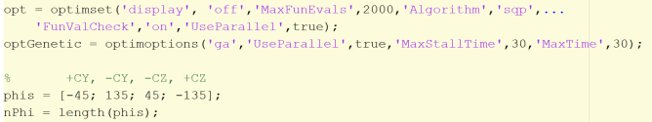
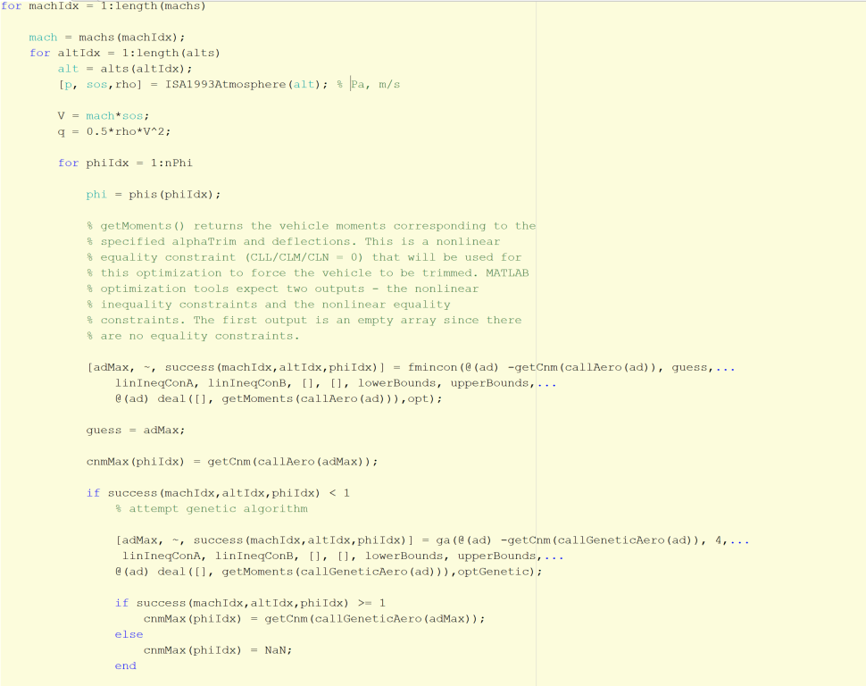

Extracting Aerodynamic G-limits (2)
Mach
Altitude
$$GLimit=C_{{nm}_{max}}∗q∗\frac{S_{ref}}{mg_{0}}$$
Roll angle (phi)
Attempt SQP
Success condition = false
Attempt GA
Success condition = true
Success condition = true
Phi increment
Success condition = false
Use structural G-limit

Slide 15
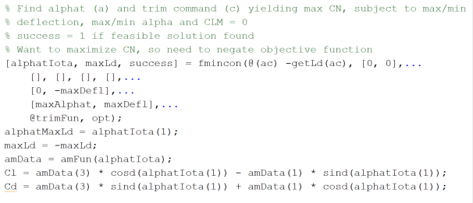


Extracting Max L/D
Want to obtain the ${L/D}_{max}$ at any flight condition
Mach and altitude
Hooks up, symmetric, so no need to handle lateral terms
Trimming only requires a single value of phi
Restricting to positive $α_{total}$ so using maneuver frame to make life easier
trimFun returns pitching moment coefficient
Yawing and rolling moment coefficients are 0 by symmetry
This is a nonlinear equality
$$C_{L}= C_{N}∗\cos{α_{T}}−C_{A}∗\sin{α_{T}}$$
$$C_{D}=C_{N}∗\sin{α_{T}}+C_{A}∗\cos{α_{T}}$$

Slide 16

Results
New midcourse guidance algorithm tested in simulation scenario
Results compared with using PN guidance throughout flight
Allowed for determination of quality of extracted aerodynamic parameters
Took several iterations to get this right
Initial issues with drag coefficient/axial acceleration component
New model showed drag 6x higher than old model
Lowered peak Mach
Once Mach dropped below 1.0, started to calculate inappropriate oscillations in sideslip
Once Mach dropped below 0.5 the bottom of the aero table, $β$ locks at ${20}^{o}$
Lead to conclusion that if the drag component could be brought down, velocity should pick up and stay within the valid bounds of the table
Should fix side force behavior

Slide 17

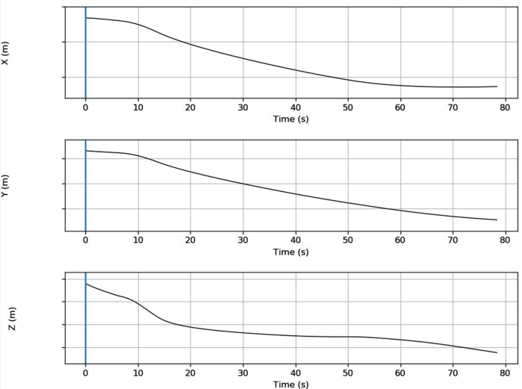



Results: How it Started – ECEF Trajectory

Slide 18
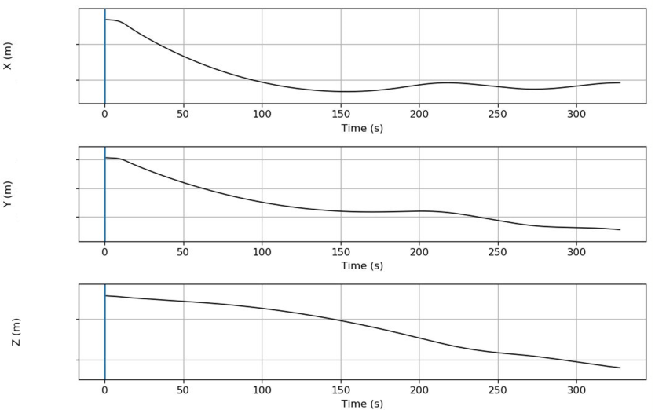
Results: How its Going – ECEF Trajectory

Slide 19
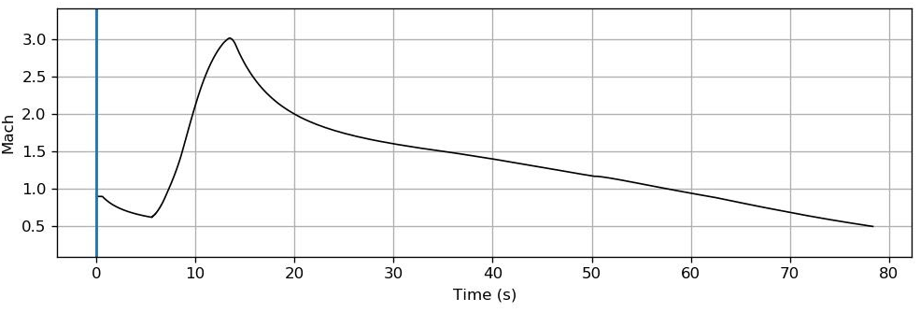
Results: How it Started – Mach

Slide 20
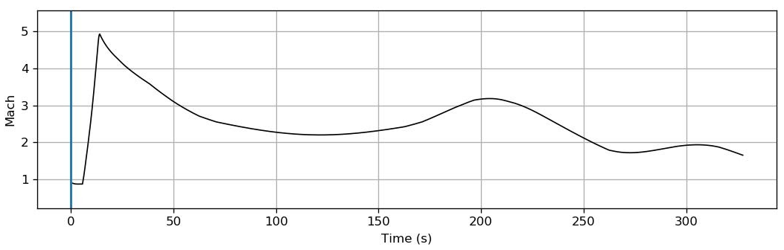
Results: How its Going –Mach

Slide 21
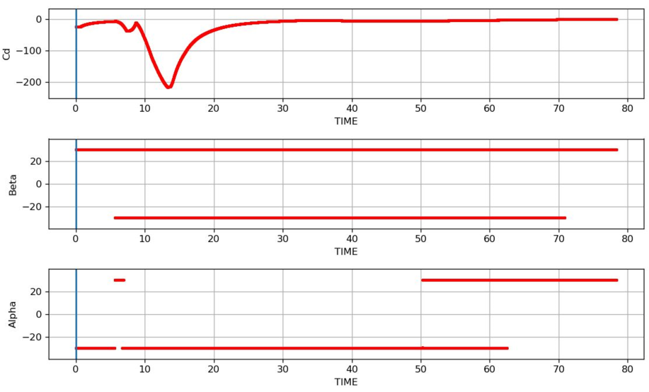
Results: How it Started – Aero Response

Slide 22
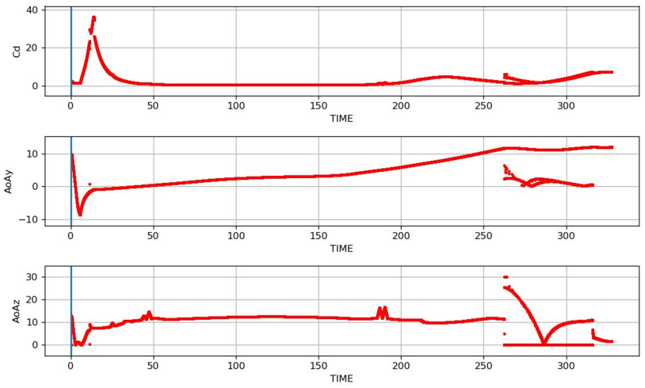
Results: How its Going – Aero Response

Slide 23
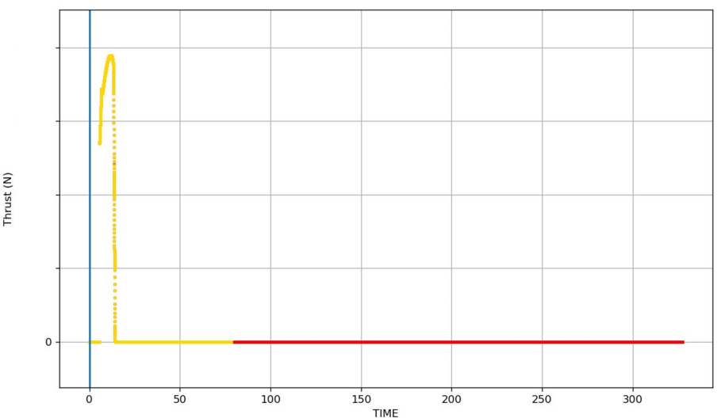
Results: Thrust Curve
Gold is using old aero
Red is using new aero
Identical thrust curves
Evidence of drag issue

Slide 24
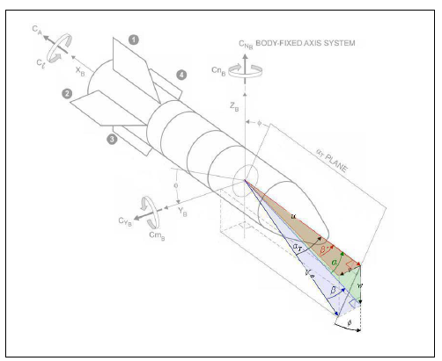
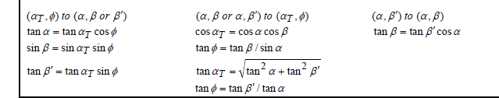
Lessons Learned
Know your reference frame
Make sure orientation lines up between model & flight code
Be willing to live with some extrapolation
Check your results
Untrimmable regions occur at non-symmetric phi
Check residuals
Make sure you’re in the right quadrant

Slide 25

Backup Slides – ${L/D}_{max}$ Guidance

Slide 26
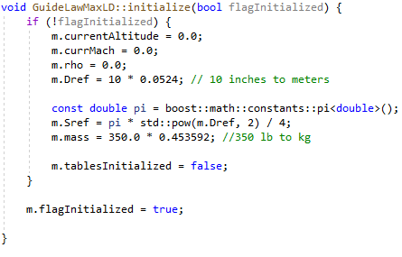
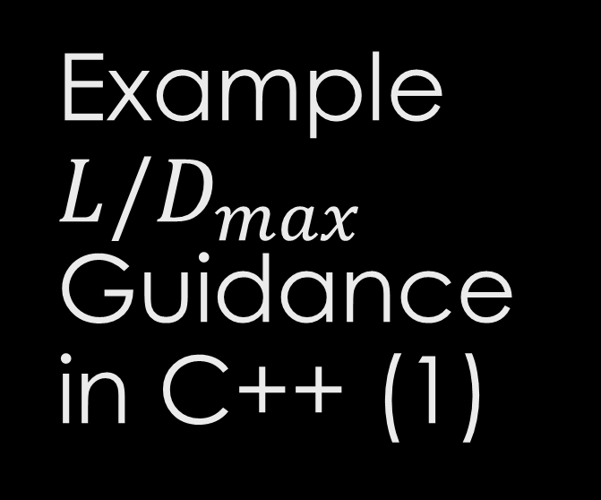
Example ${L/D}_{max}$ Guidance in C++ (1)
Note: This is just to serve as a general outline rather than actual production code

Slide 27
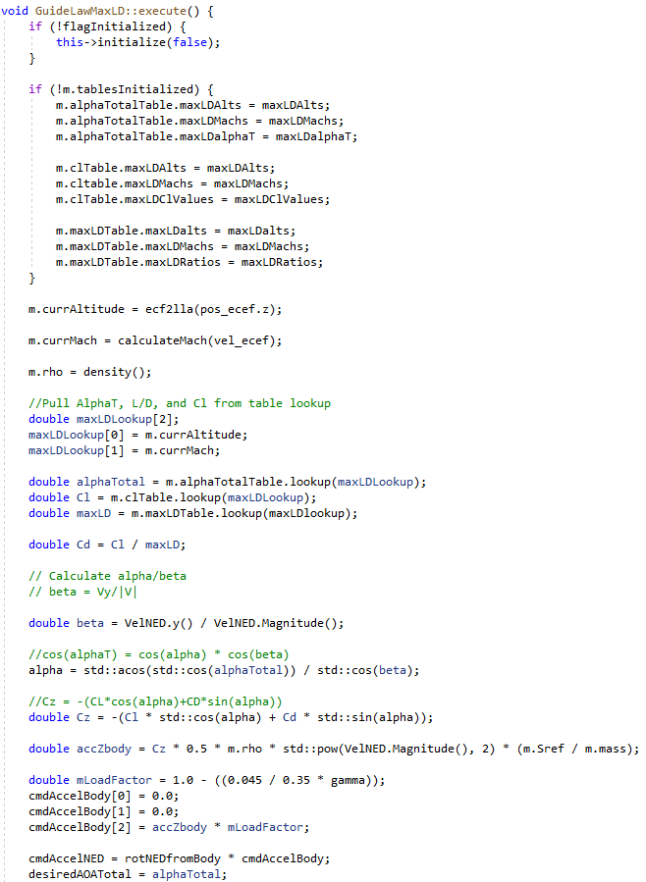
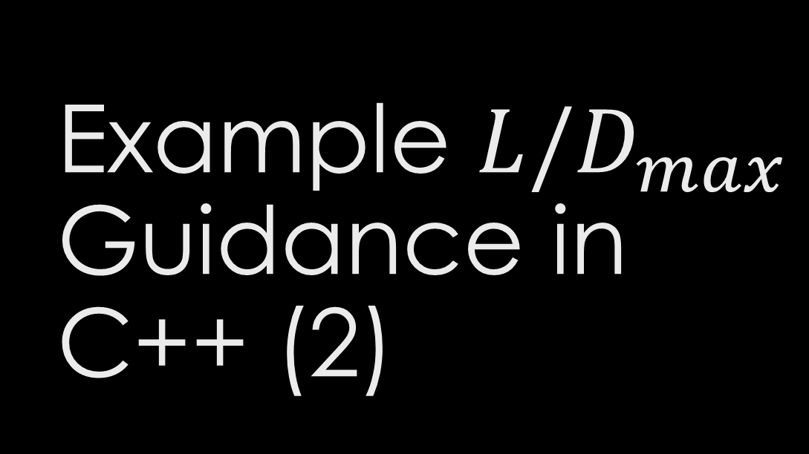
Example ${L/D}_{max}$ Guidance in C++ (2)

Slide 28
Backup Slides – Nonlinear Programming

Slide 29

The goal: Karush-Khun-Tucker Conditions
Let $f:ℝ^{n}→ℝ$ be a cost function. Let $g:ℝ^{n}→ℝ^{p}$ be the equality constraint function. Let $h:ℝ^{n}→ℝ^{q}$ be the inequality constraint function. $f$, $g$ and $h$ are differentiable functions. The objective is to solve the constrained optimization problem $\min_{x}{f(x)}$ $subject to g\left(x\right)≥0$ $subject to h\left(x\right)=0$
The KKT conditions are necessary (but not sufficient¹) conditions for optimality. The KKT conditions state that under certain regularity conditions/constraint qualifications, there exist $μ∈ℝ^{p}$ and $λ∈ℝ^{q}$ such that when evaluated at a local minimum of $f$,
Stationary Condition ${\left.\frac{∂f}{∂x }\right|}_{x^{∗}}−μ^{T}{\left.\frac{∂g}{∂x }\right|}_{x^{∗}}−λ^{T}{\left.\frac{∂h}{∂x }\right|}_{x^{∗}}=0$
Primal Feasibility Condition $g\left(x^{∗}\right)≥0$ $h\left(x^{∗}\right)=0$
Dual Feasibility Condition $μ≥0$
Complementary Slackness Condition $μ^{T}g\left(x^{∗}\right)=0$

Slide 30

Quadratic Programming Algorithm Overview
The quadratic programming problem is $\min_{x}{f\left(x\right)=\frac{1}{2}x^{T}Hx+g^{T}x+c}$ $subject to h\left(x\right)=Ax−b=0$
Applying KKT conditions gives $\frac{∂f}{∂x}−λ^{T}\frac{∂h}{∂x}=0$ $h\left(x\right)=0$
Rewriting gives the system of equations above gives $\left[\begin{matrix}H & A^{T} \\ A & 0\end{matrix}\right]\left[\begin{matrix}x \\ λ\end{matrix}\right]=\left[\begin{matrix}−g \\ b\end{matrix}\right].$

Slide 31

Sequential Quadratic Programming Algorithm Overview
Sequential quadratic programming is the sequential application of quadratic programming to a quadratic program obtained by the approximation of the problem. Take the problem $\min_{x}{f\left(x\right)≈\frac{1}{2}{\left(x−x_{k}\right)}^{T}\frac{d^{2}f}{dx^{2}}{\left.​\right|}_{x_{k}}\left(x−x_{k}\right)+\frac{df}{dx}{\left.​\right|}_{x_{k}}\left(x−x_{k}\right)+f\left(x_{k}\right)}$ $subject to g\left(x\right)≈\frac{∂g}{∂x}{\left.​\right|}_{x_{k}}\left(x−x_{k}\right)$
Denote $x−x_{k}=Δx$ and solve for it with quadratic programming.
Update for next iteration : $x_{k+1}=x_{k}+αΔx$, $α>0.$
Note: to ensure a descent-direction $\frac{d^{2}f}{dx^{2}}$ should be positive definite. If it isn’t, it can be made to be positive definite by perturbing it before solving or perturbing it during the solution process

Slide 32
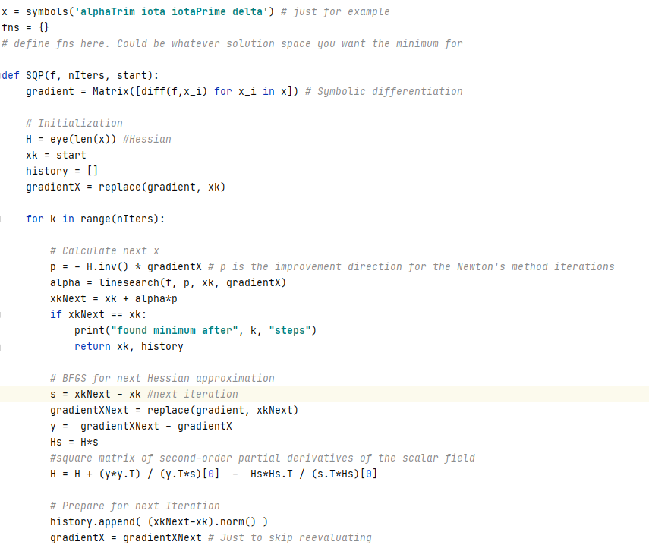
SQP in Python (1)

Slide 33
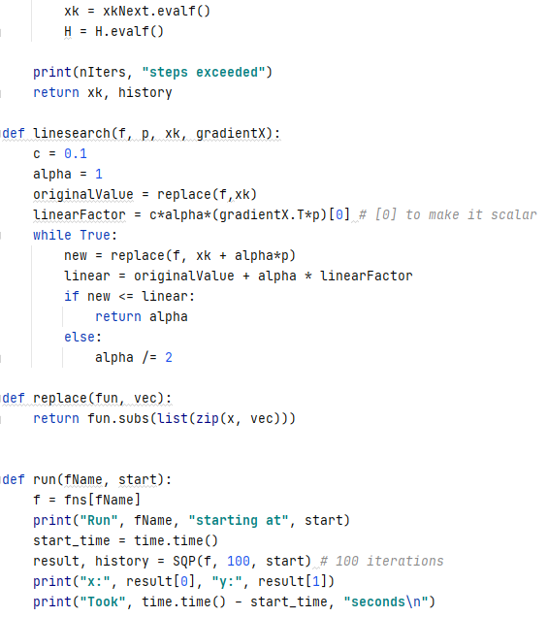
SQP in Python (2)

Slide 34
Backup Slides – Aerodynamics Model

Slide 35
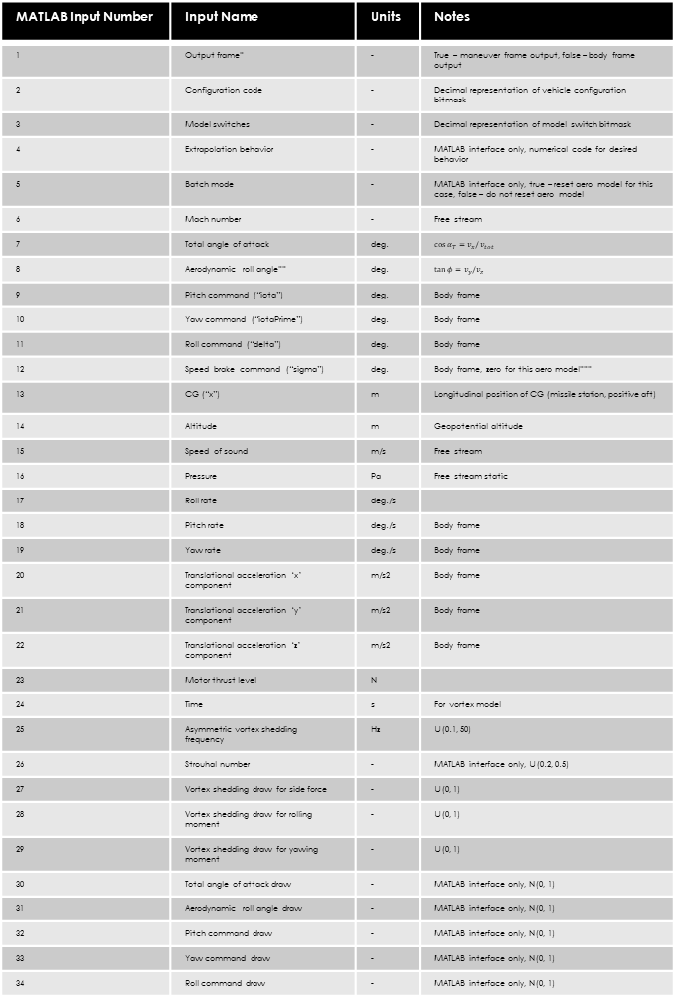
Aerodynamics Model I/O (MATLAB)
MATLAB Input Number | Input Name | Units | Notes
1 | Output frame* | - | True – maneuver frame output, false – body frame output
2 | Configuration code | - | Decimal representation of vehicle configuration bitmask
3 | Model switches | - | Decimal representation of model switch bitmask
4 | Extrapolation behavior | - | MATLAB interface only, numerical code for desired behavior
5 | Batch mode | - | MATLAB interface only, true – reset aero model for this case, false – do not reset aero model
6 | Mach number | - | Free stream
7 | Total angle of attack | deg. | $$\cos{α_{T}}=v_{x}/v_{tot}$$
8 | Aerodynamic roll angle** | deg. | $$\tan{φ}=v_{y}/v_{z}$$
9 | Pitch command (“iota”) | deg. | Body frame
10 | Yaw command (“iotaPrime”) | deg. | Body frame
11 | Roll command (“delta”) | deg. | Body frame
12 | Speed brake command (“sigma”) | deg. | Body frame, zero for this aero model***
13 | CG (“x”) | m | Longitudinal position of CG (missile station, positive aft)
14 | Altitude | m | Geopotential altitude
15 | Speed of sound | m/s | Free stream
16 | Pressure | Pa | Free stream static
17 | Roll rate | deg./s
18 | Pitch rate | deg./s | Body frame
19 | Yaw rate | deg./s | Body frame
20 | Translational acceleration ‘x’ component | m/s2 | Body frame
21 | Translational acceleration ‘y’ component | m/s2 | Body frame
22 | Translational acceleration ‘z’ component | m/s2 | Body frame
23 | Motor thrust level | N
24 | Time | s | For vortex model
25 | Asymmetric vortex shedding frequency | Hz | U(0.1, 50)
26 | Strouhal number | - | MATLAB interface only, U(0.2, 0.5)
27 | Vortex shedding draw for side force | - | U(0, 1)
28 | Vortex shedding draw for rolling moment | - | U(0, 1)
29 | Vortex shedding draw for yawing moment | - | U(0, 1)
30 | Total angle of attack draw | - | MATLAB interface only, N(0, 1)
31 | Aerodynamic roll angle draw | - | MATLAB interface only, N(0, 1)
32 | Pitch command draw | - | MATLAB interface only, N(0, 1)
33 | Yaw command draw | - | MATLAB interface only, N(0, 1)
34 | Roll command draw | - | MATLAB interface only, N(0, 1)
Index | Output Name
1 | Axial force coefficient (CA)
2 | Side force coefficient (CY)
3 | Normal force coefficient (CN)
4 | Rolling moment coefficient (CLL)
5 | Pitching moment coefficient (CLM)
6 | Yawing moment coefficient (CLN)
7 | Fin 1 panel normal force coefficient (CNF1)
8 | Fin 2 panel normal force coefficient (CNF2)
9 | Fin 3 panel normal force coefficient (CNF3)
10 | Fin 4 panel normal force coefficient (CNF4)
11 | Fin 1 panel hinge moment coefficient (CHM1)
12 | Fin 2 panel hinge moment coefficient (CHM2)
13 | Fin 3 panel hinge moment coefficient (CHM3)
14 | Fin 4 panel hinge moment coefficient (CHM4)
15 | Fin 1 panel bending moment coefficient (CBM1)
16 | Fin 2 panel bending moment coefficient (CBM2)
17 | Fin 3 panel bending moment coefficient (CBM3)
18 | Fin 4 panel bending moment coefficient (CBM4)
19 | Rolling moment damping coefficient (CLLP, 1/deg.)
20 | Body frame pitching moment damping coefficient due to body frame pitch rate (CLMBQ, 1/deg.)
21 | Body frame yawing moment damping coefficient due to body frame yaw rate (CLNBR, 1/deg.)
22 | Maneuver frame pitching moment damping coefficient due to total angle of attack rate (CLMMAD, 1/deg.)
Call aeromodel with a single M-by-N matrix of cases
M = 34 (inputs on right)
N = number of cases
Returns 22 X N matrix of outputs (outputs on right)
N = number of cases
“Batch mode” (input 5) – when enabled, aero model is reset for the current case
Means the case is independent of previous cases, but some vortex/uncertainty model assumptions may be violated
When disabled, aero model is not reset, so history of calls to the model (since the last time model was reset) affect results
E.g. vortex shedding depends on time and history of calls to aero model (random shedding frequency etc.)
This is how a 6-DOF would use the model
Disable batch mode for single trajectory analysis or any use case where correct vortex modeling/uncertainty modeling/call history dependent behavior is desired
Enable batch mode for any use case where cases are not related to one another (e.g. making a stability map or running a trade matrix)

Slide 36


Damping
Panel
Damping contribution to main moment coefficients is $$C_{damp} \left(\frac{ωl_{ref}}{2v_{tot}}\right)$$
Where $ω$ is the body rate along the corresponding axis
Aero model will calculate damping coefficients whether the damping model switch is enabled or not
Damping model switch only determines if damping contributions should be included in main moment coefficients
Damping coefficients are only a function of Mach number in the aero model
True damping coefficients (except CLLP) will vary with longitudinal position of CG, among other things
Damping coefficients used in aero model correspond to a CG at the moment reference point
This means the damping outputs will be increasingly incorrect as the CG moves away from the MRP
Damping contribution to main moment coefficients:
Nondimensionalize by $\frac{ωl_{ref}}{2v_{tot}}$
$ω$ is the angular rate corresponding to the damping coefficient
Ex. $CLL_{damp}=CLLP\frac{l_{ref}p}{2v_{tot}}$ since the corresponding angular rate is p (roll rate)
CHM
Y-axis
Panel coordinate frame rotates with the panel as it deflects
Leading Edge
Unlisted coefficients assumed negligible (e.g. panel force along panel ‘X’ axis)
Hinge line
Z-axis
CBM
Damping Coefficient | Notes
CLLp (1/deg.) | Rolling moment damping due to roll rate (p)
CLMbq (1/deg.) | Pitching moment damping due to body pitch rate (q)
CLNbr (1/deg.) | Yawing moment damping due to body yaw rate (r)
CLMmad (1/deg.) | Pitching moment damping due to total angle of attack rate (ad)
X-axis
-CNF
Panel Coefficient | Force/Moment Coefficient
CNF | -CFz_panel
CHM | CMy_panel
CBM | -CMx_panel

Slide 37
Uncertainty Model
Captures manufacturing, modeling and data uncertainty sources
Manifests as an adjustment to the aerodynamics model input values
Uncertainty values are assumed to be drawn once for a trajectory – enabling batch mode in MATLAB interface will reset the uncertainty model for the current case

